Slide 1
Telco Customer Churn Prediction
Kalum De Alwis​​ - 265

Slide 2

Introduction
The telecom industry has traditionally experienced an average churn rate of 30% to 35%, while the cost per acquisition (CPA) typically ranges from five to 10 times higher than the cost of retaining an existing customer, according to the 2016 sector review Big Data Applications in the Telecommunications Industry.

Slide 3
Problem
This Project tries to predict churn of customer in a telco environment using machine learning
Data set
Data set is WA_Fn-UseC_-Telco-Customer-Churn.csv which is sourced from https://www.kaggle.com/datasets/palashfendarkar/wa-fnusec-telcocustomerchurn
Algorithms in consideration
Since this is a binary classification problem Random forest and logistic regression were targeted as possible ML algorithms.

Slide 4
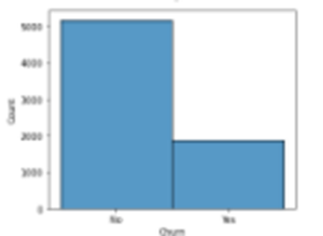
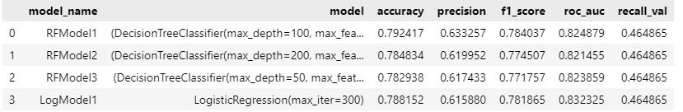




Model
Pre processing
Model building
Model
Deployment
Data set consisted of 21 columns and 7043 rows. Data set had only 3 numerical features and 17 categorical features, it did not contain null values
Target variable which is ‘Churn’ had 1869 (26%) samples with ‘Yes” values and 5174 with ‘no’ values (figure 3). Therefore, no special sampling was not done to the test data set considering the nature of telco churn
Random forest and Logistic regression algorithms were used.
Hyper parameter change
Logistic regression failed to converge with default hyper [parameters and had to set “max_iter=300” to solve the issue.
Model was saved using joblib and functions were created to load the model and provide churn prediction for input data sets by user.

Slide 5
Annexures

Slide 6
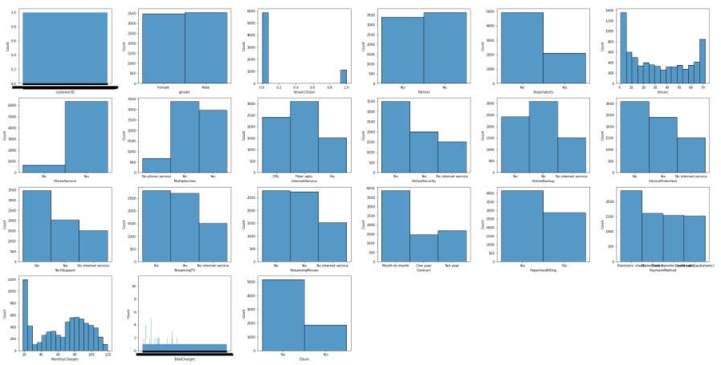
Data analysis -1

Slide 7
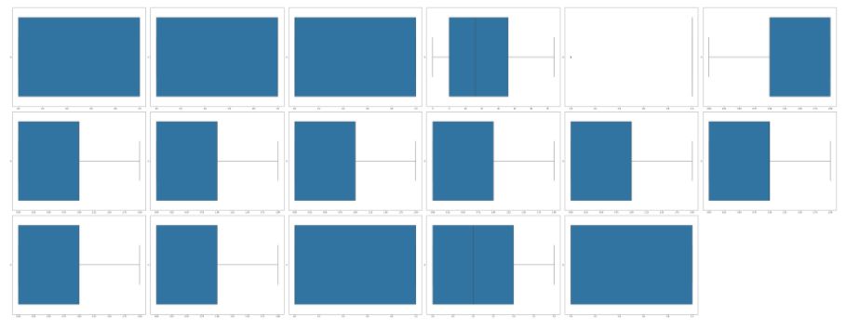

Data analysis -1
Figure 3 Target Variable Bias
Figure 2 outliers

Slide 8
Model Evaluation
Random forest algorithm-based model RFModel1 gave much better F1, recall, precision scores

Slide 9
Thank you
Kalum De Alwis
265
ML Batch 2

